Slide 1
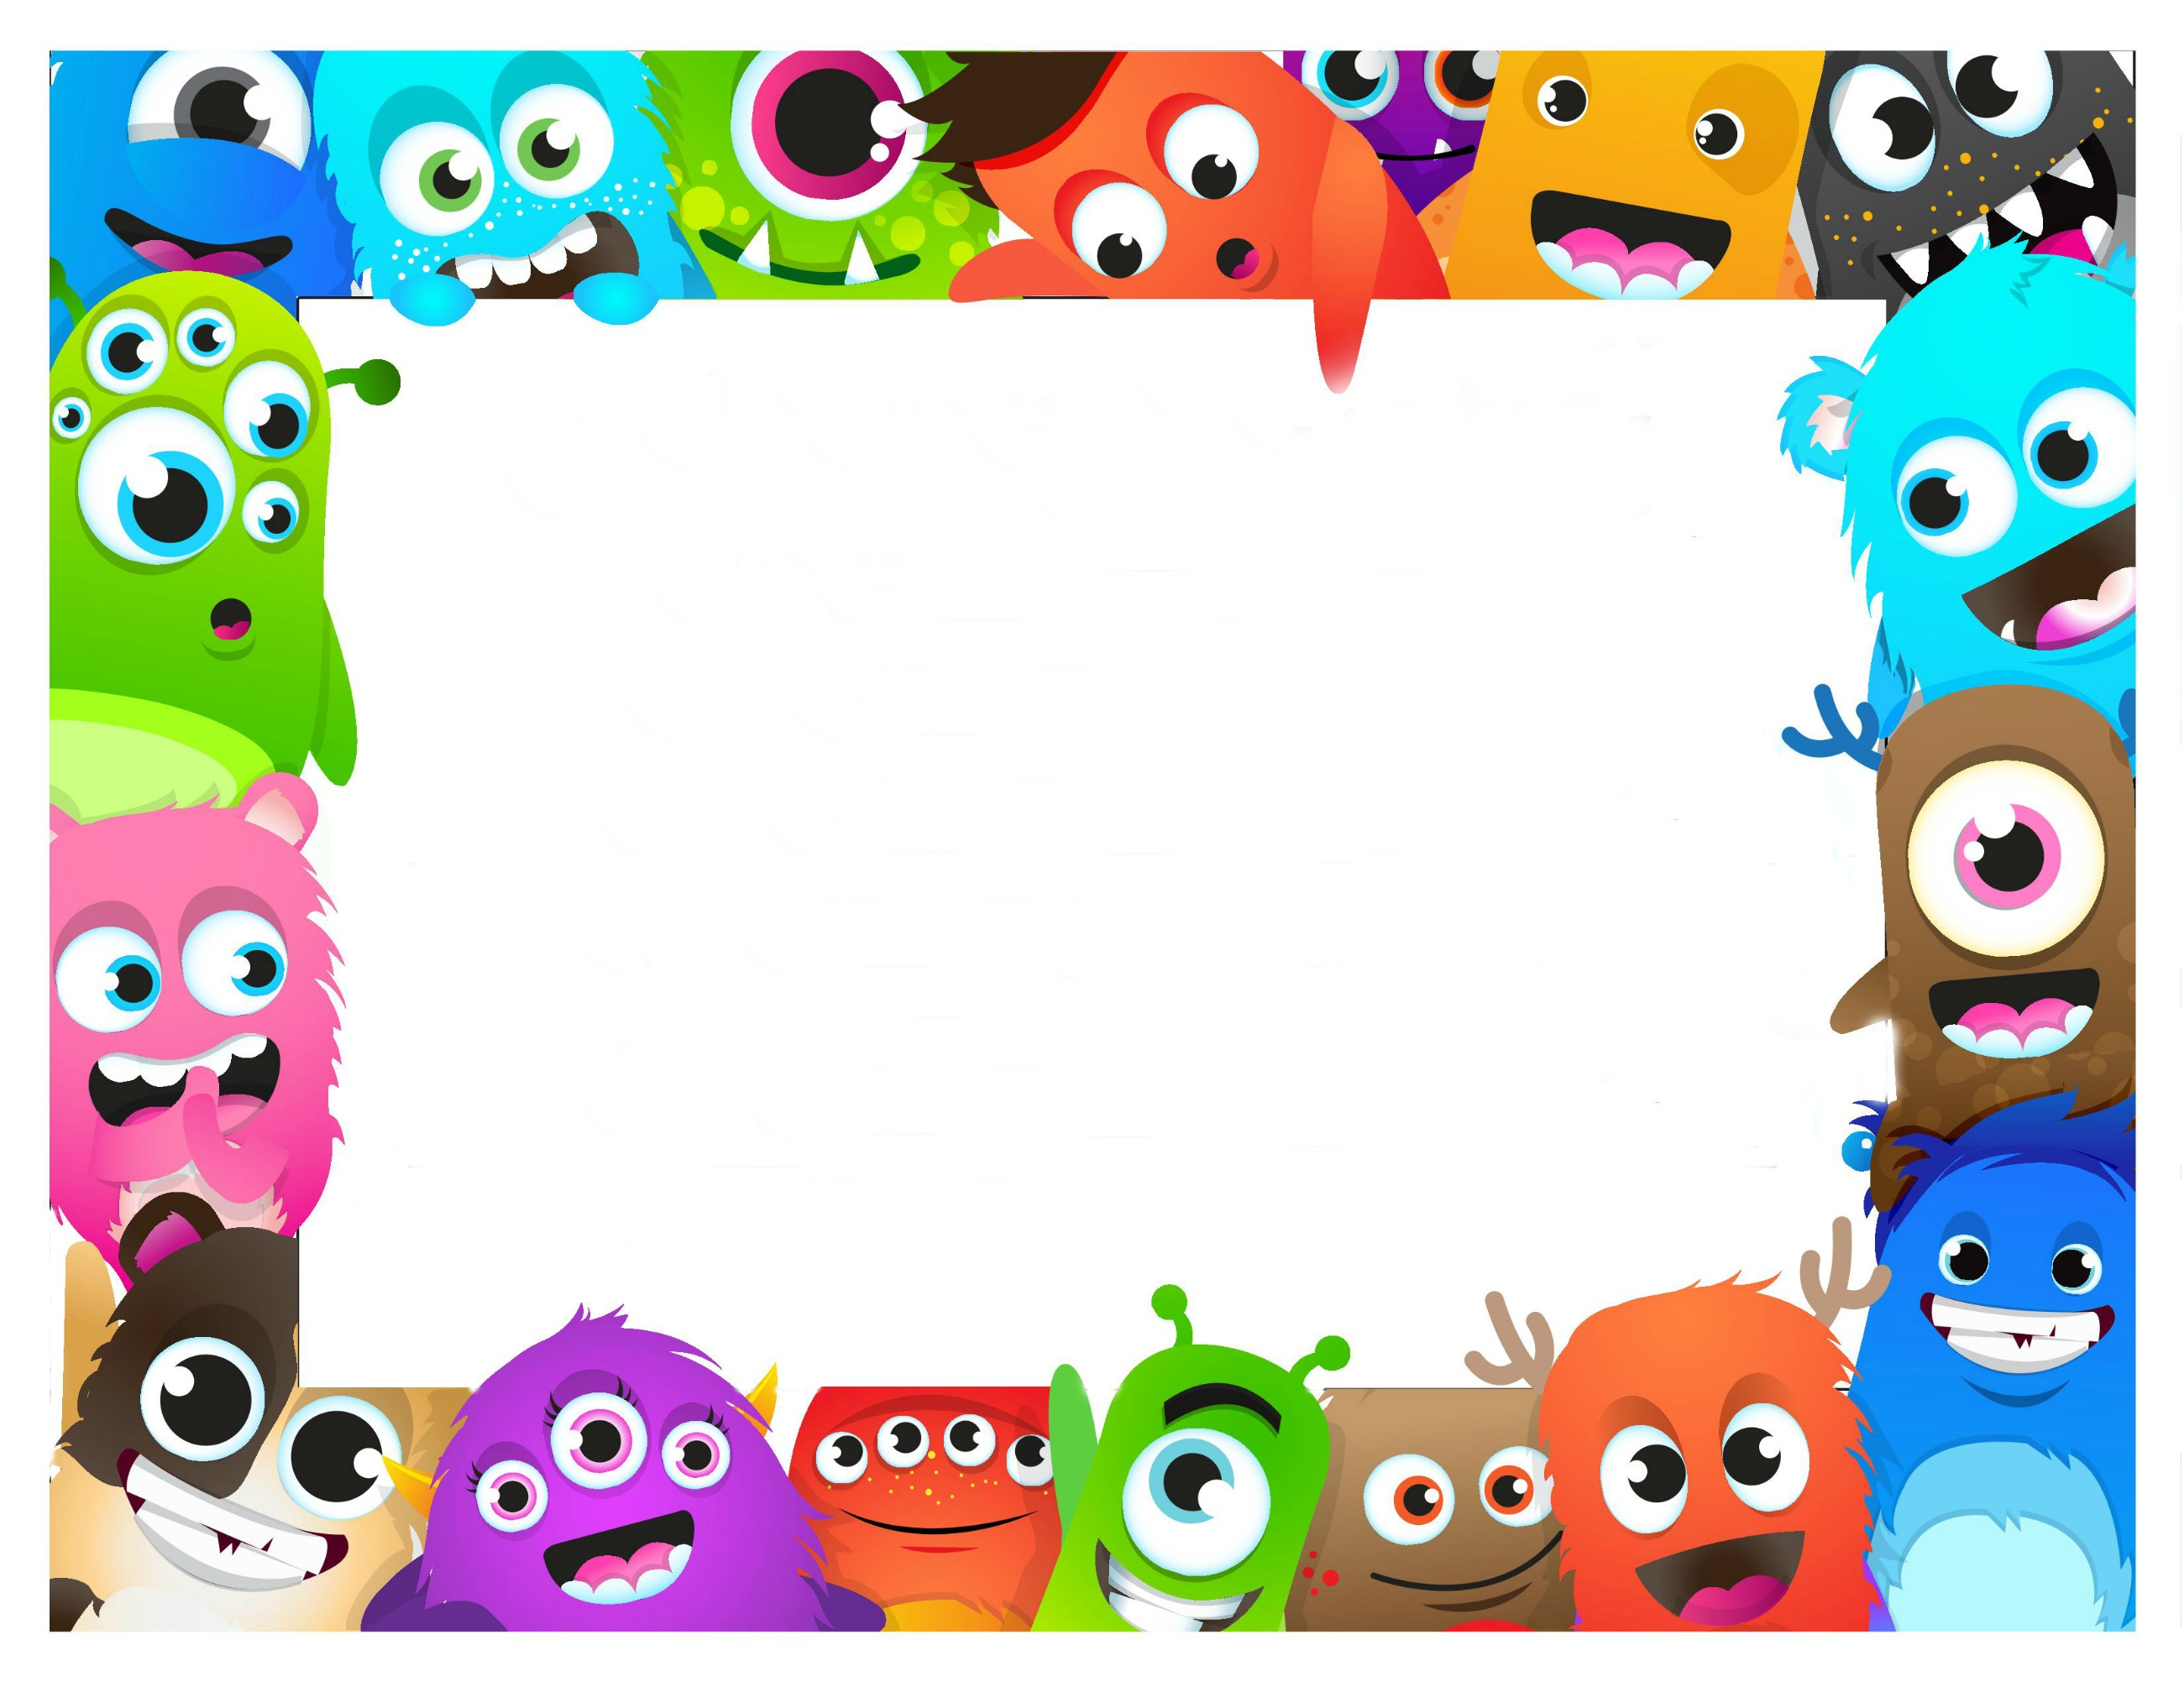
26 pts = Leader Box
22 = Sticker Sheet
18 = Tattoo AND Candy
14 = 1 Candy (OR 2 Stickers)
10 = 1 Sticker
5 = Hand Stamped

Slide 2
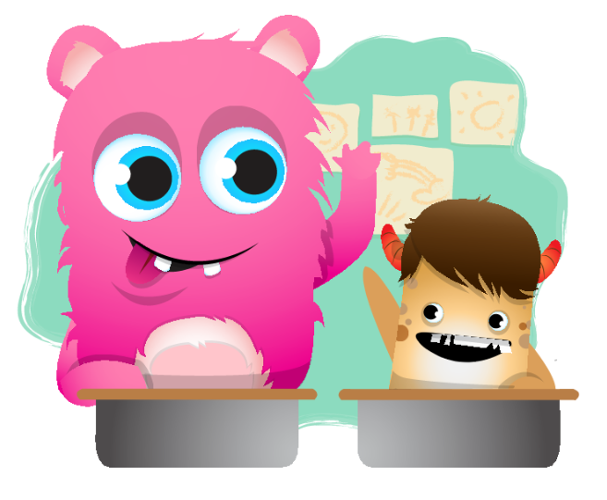
I can wait my turn to talk.

Slide 3
I can
always
try.

Slide 4
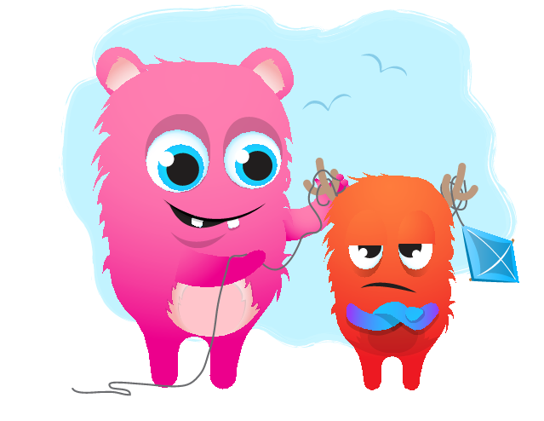
I can belly breathe.
If my feelings
take over my thoughts.

Slide 5
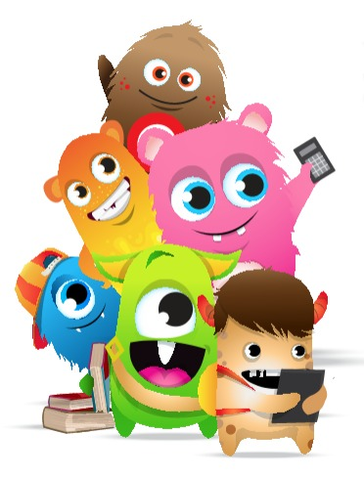
I can be happy
for my friends.

Slide 6
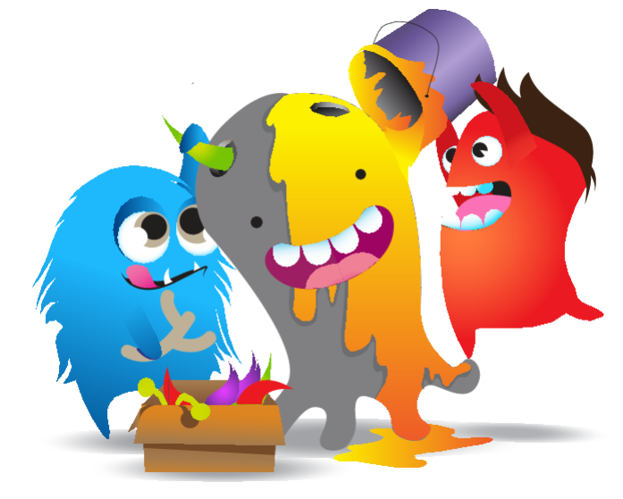
LEARN FROM YOUR MISTAKES

